Slide 1
IP Addressing
Lab theory

Slide 2
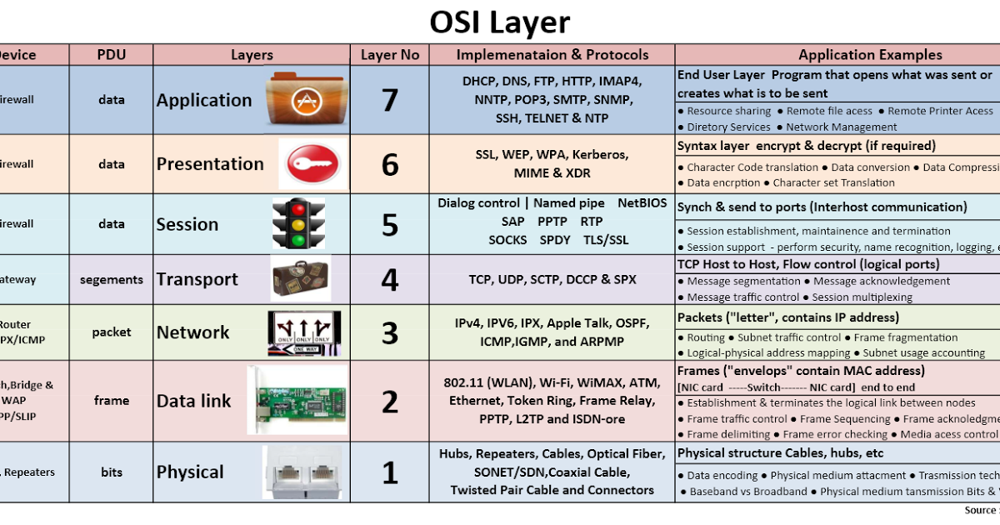

Slide 3
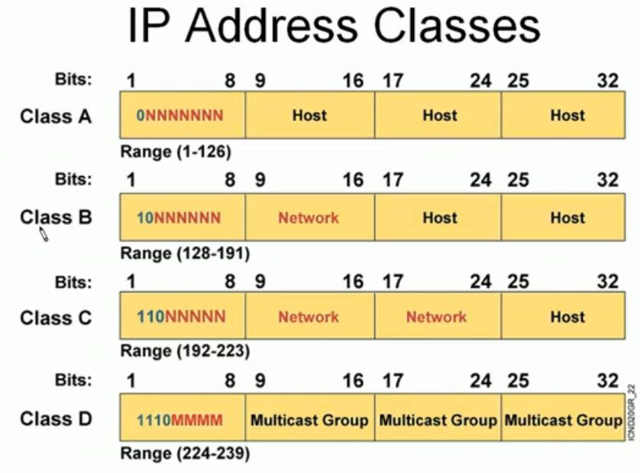

Slide 4
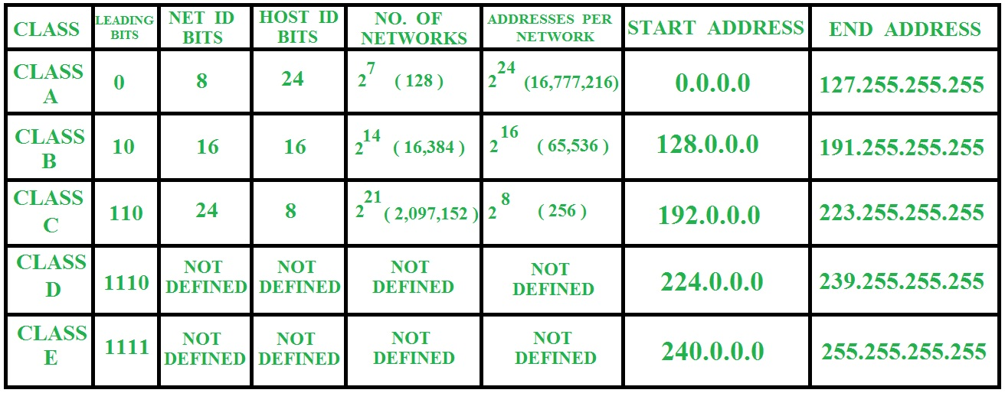

Slide 5
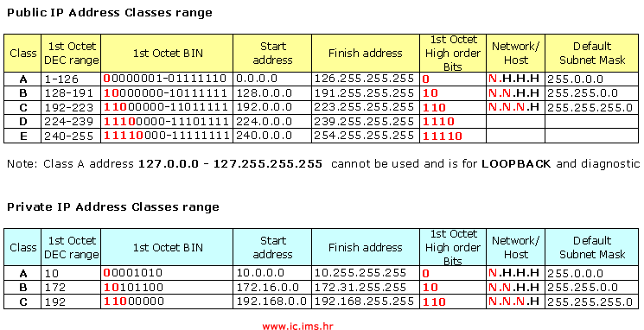

Slide 6
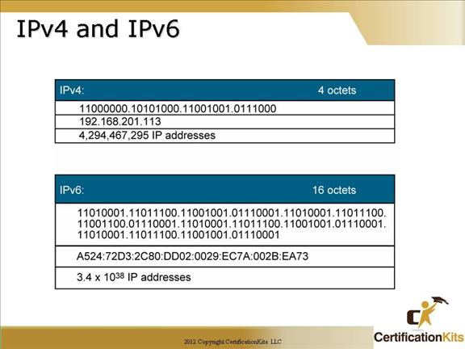

Slide 7
IANA (Internet Assigned Numbers Authority) is the organization under the Internet Architecture Board (IAB) of the Internet Society that,under a contract from the U.S. government has overseen the allocation of Internet Protocol addresses to Internet service providers (ISPs).

Slide 8
Basically class A IP starts from 1.0.0.0 to 127.255.255.255.
In this range the network 10.0.0.0 is dedicated for use in Private network. For example if you have an office you can configure the network devices with IP starting from 10.0.0.1 to 10.255.255.254 only.
All other IPs are held at service provides, only we can do is purchase it from them
In the Internet Protocol version 4 the address 0.0.0.0 is a non-routable meta-address used to label an invalid, unknown or non-applicable target.
0.0.0.0 can be seen initially as a default IP address. It is the IP that is used by a computer that DHCP allocation fails, but it is associated with a network.

Slide 10
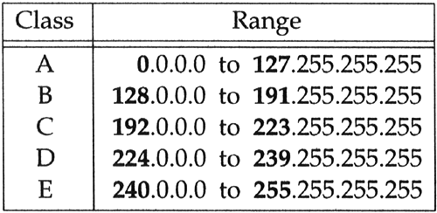
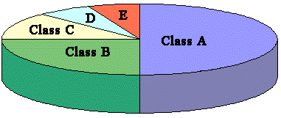

Slide 11
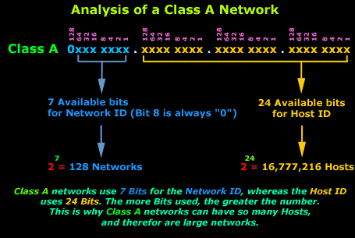

Slide 12
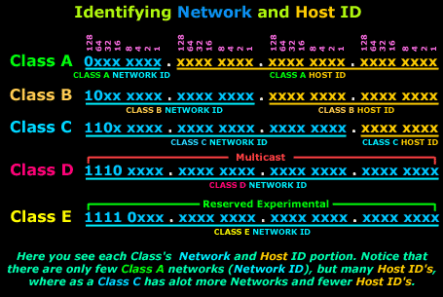

Slide 13
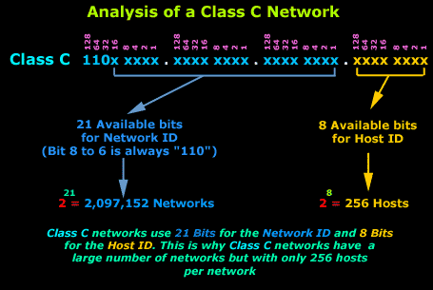

Slide 14
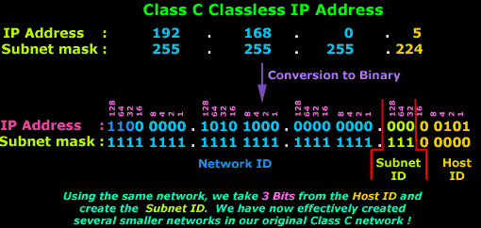
Result:

Slide 15

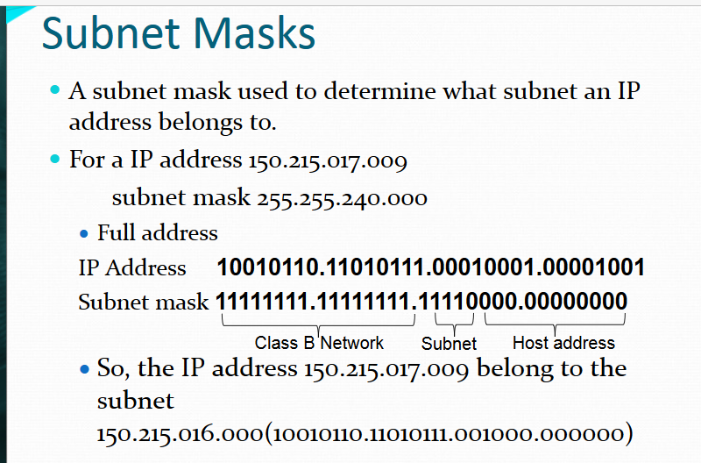

Slide 16
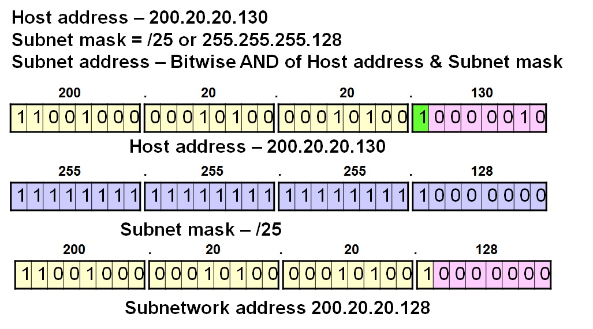

Slide 17
Dns
Ping –ttl, -n 10, -t
Icmp:
TTL- Time to Live
The Internet Control Message Protocol (ICMP) is a supporting protocol in the Internet protocol suite. It is used by network devices, like routers, to send error messages and operational information indicating, for example, that a requested service is not available or that a host or router could not be reached.^{[1]}
Arp:
When an incoming packet destined for a host machine on a particular local area network arrives at a gateway, the gateway asks the ARP program to find a physical host or MAC address that matches the IP address.
Gateway
Port address
Logical
Physical address

